Slide 1
ARDUINO BASED ECG MONITORING HEALTHCARE SYSTEM
R.KISHORE R.NAVANEEDHA KRISHNAN R.SALMON FAROSE
Guided By:
221005032
221005042
221005051
Prof M.Chandrasekhar

Slide 2
INTRODUCTION:
Heart disease was becoming a big disease which health killer people for many years.
Hence, most health care equipment and monitoring system are designed to keep track the disease.
As we know that by analyzing or monitoring the ECG signal at initial stage these disease can be prevented.So i am working in this project .

Slide 3
ABSTRACT:
Heart rate, body temperature and blood pressure are very critical parameters of human body.In this project, we have proposed ECG MONITORING SYSTEM based on ARDUINO. This system calculates heart rate of patient and sends the value of heart rate in beats per minute (bpm) to a database on cloud. Using this system doctors at hospital can analyse the critical parameters sent by this system.

Slide 4
HARDWARE REQUIREMENTS:
1)Arduino Uno/Mega/Nano. 2)ECG Module (AD8232).
ECG Electrodes - 3 pieces.
ECG Electrode Connector -3.5 mm. 5)Power supply.
6)Connecting Wires.

Slide 5
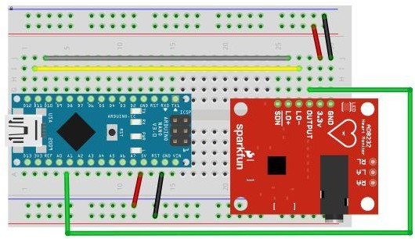
CIRCUIT DIAGRAM:
Arduino 3.3V -- 3.3V pin
Arduino pin 10 -- L0+
Arduino Pin 11 -- L0-
Arduino Analog1(A1)--O/P
Arduino Gnd -- Gnd

Slide 6
FURTURE IMPLEMENTATION:
Interfacing GSM module with the ardunio board can help the doctors to monitor the heart rate through SMS.

Slide 7
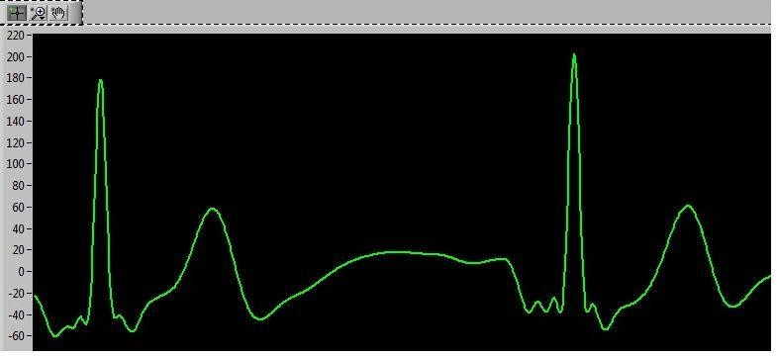
OUTPUT:

Slide 8
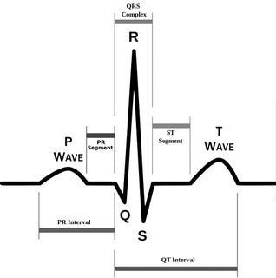
ECG SIGNAL PARAMETERS:

Slide 9
REFERENCES:
Muhammad Wildan Gifari ; Hasballah Zakaria ; Richard Mengko: Design of ECG Homecare: 12-lead ECG acquisition using single channel ECG device developed on AD8232 analog front end, The 5th International ConferenceElectricalEngineeringandInformatics2015Aug ust10-11,2015,Baliindonesia,978-1-4673-7319-7/15/$31. 00 ©2015 IEEE, pp 371-376.

Slide 10
ADVANTAGES:
Data can be uploaded or directly sent to the doctors by using IOT Technology .
By using more electrodes measurement can be more accurate .

Slide 11
APPLICATIONS:
1)Fitness and activity heart rate monitors. 2)Portable ECG Remote health monitors. 3)Gaming peripherals.
4)Biopotential signal acquisitions.

Slide 12
CONCLUSION:
This research paper aims at initial prototype development for wireless transmission of ECG signals. It is evident that designing such a system will help in early detection of abnormal conditions of cardiovascular diseases and prevention of its serious consequences .

